Slide 1
Intelligent Speech Analysis for Facial Paralysis:
An Innovative Diagnostic Approach
FDI World Dental Congress 2025 - Oral Presentation
Notes:
换照片

Slide 2
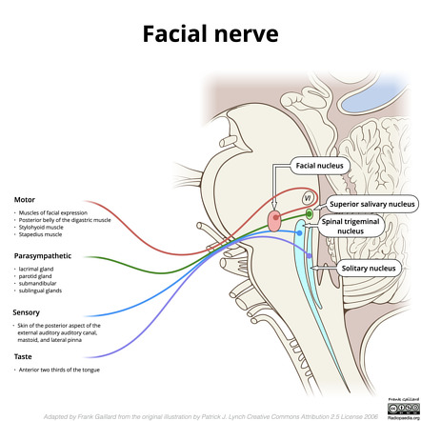
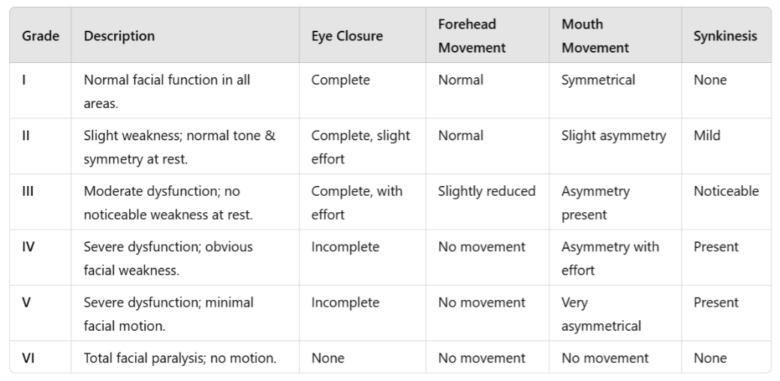
Part 1 Background
• Facial paralysis: significant in oral & maxillofacial surgery
• Current diagnosis:
House-Brackmann scale →subjective 
Electromyography → accurate but expensive 
• Unmet Need: objective, quantifiable, cost-effective diagnostic tool

House-Brackmann scale

Slide 3
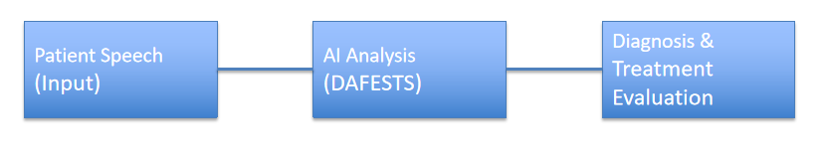

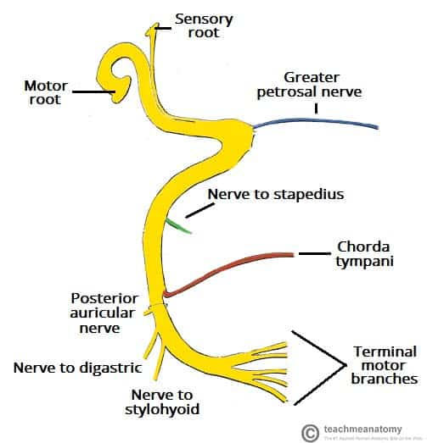
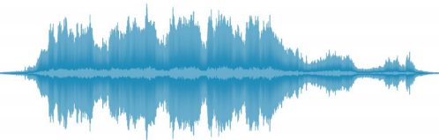
Part 2 Research Aim
• Develop DAFEST
→ Dynamic Acoustic-based Facial paralysis diagnosis Early Screening & Treatment System
Based on intelligent speech analysis
→Provide objective, interpretable, AI-driven evaluation

Slide 4
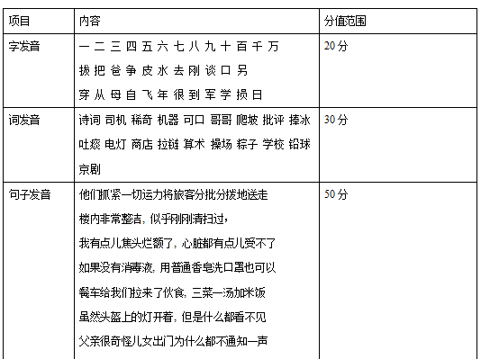
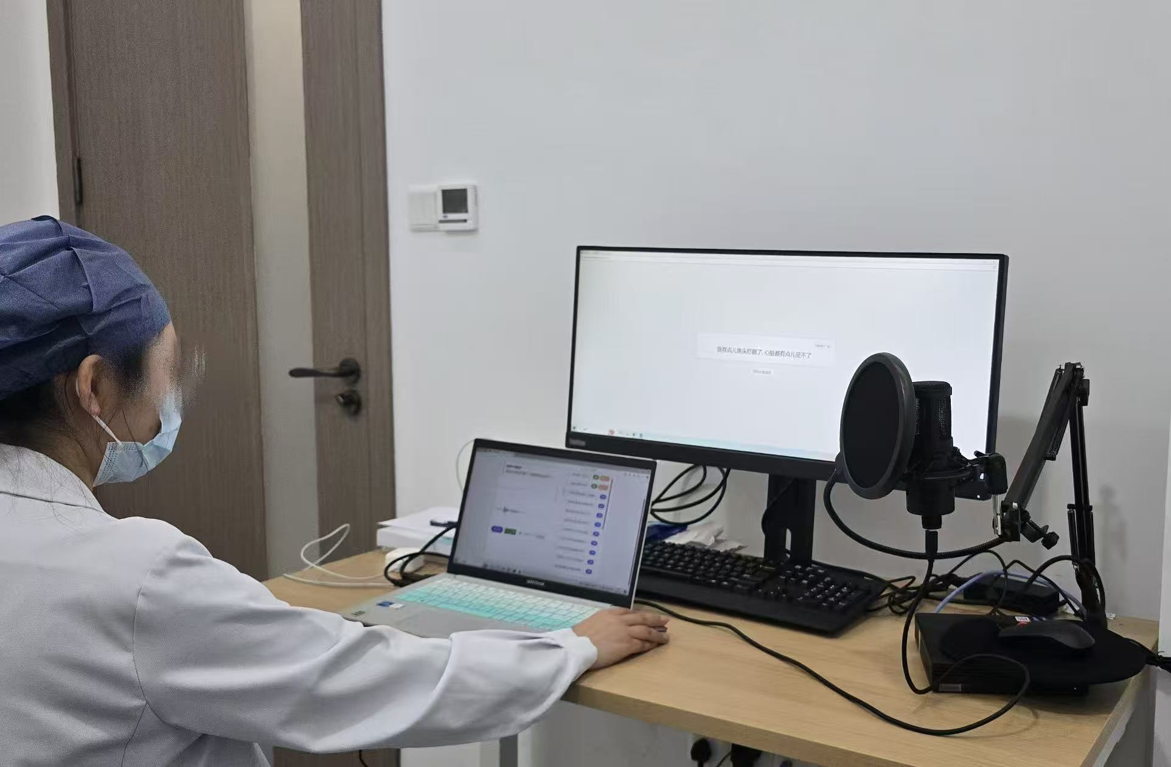
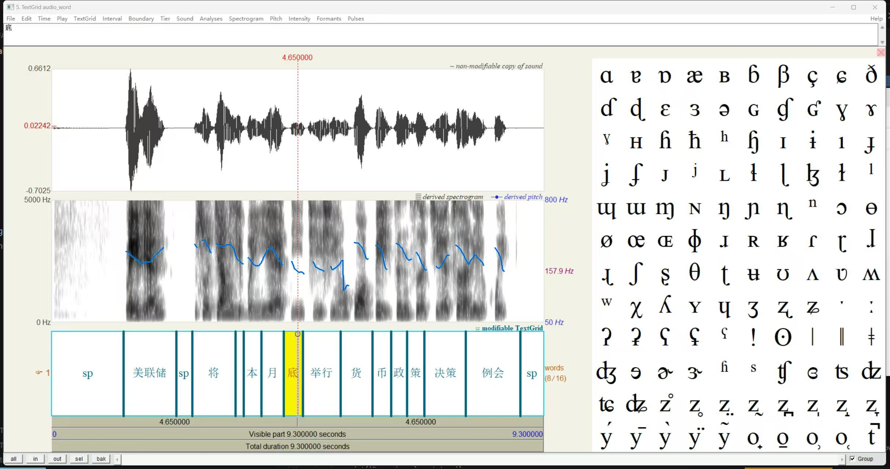
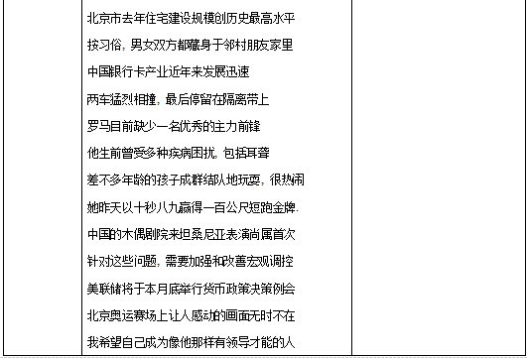
Part 3 Study Design & Participants
• Ethics approved
• N = 100 idiopathic facial paralysis patients (18–70 yrs)
• Age and gender matched healthy controls
• Tailored facial paralysis speech assessment scale
• Standardized speech acquisition device
Dedicated voice acquisition equipment
Tailored scale

Slide 5
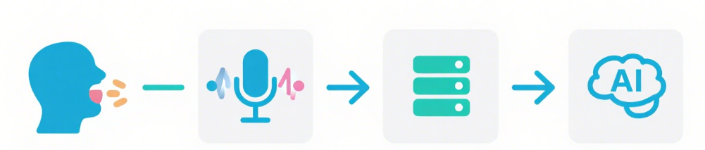
Part 4 Data Collection Scheme
• High-fidelity speech recording device
• Tasks: sustained vowels, syllables, connected speech
• Standardized quiet environment
• Established first speech biomarker database for facial paralysis
Patients speak
Equipment Collection
Database
AI analytics

Slide 6

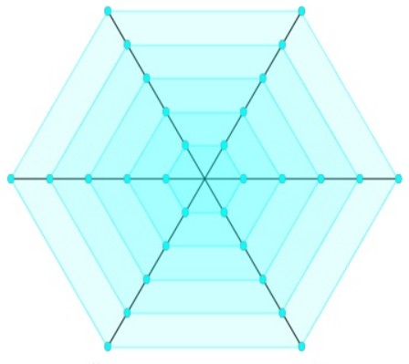
Part 5 Analysis Method – Acoustic
Feature Matrix
Six key dimensions:
Fundamental frequency
Nasalization degree
Spectrographic signatures
Formant frequencies
Pause dynamics
Speech tempo

Slide 7
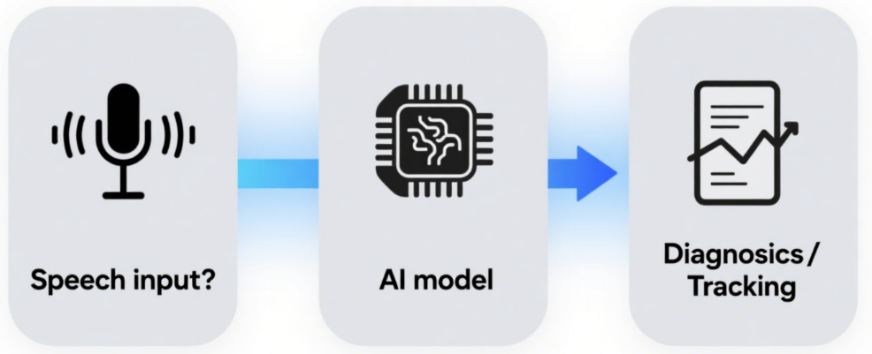
Part 6 DAFESTS Workflow
Input: Patient speech → AI extracts features
Feature sensitivity algorithm → anomaly detection
Output: Early screening, prognostic tracking, treatment evaluation
Diagnosis/
Tracking
Speech input
AI model

Slide 8
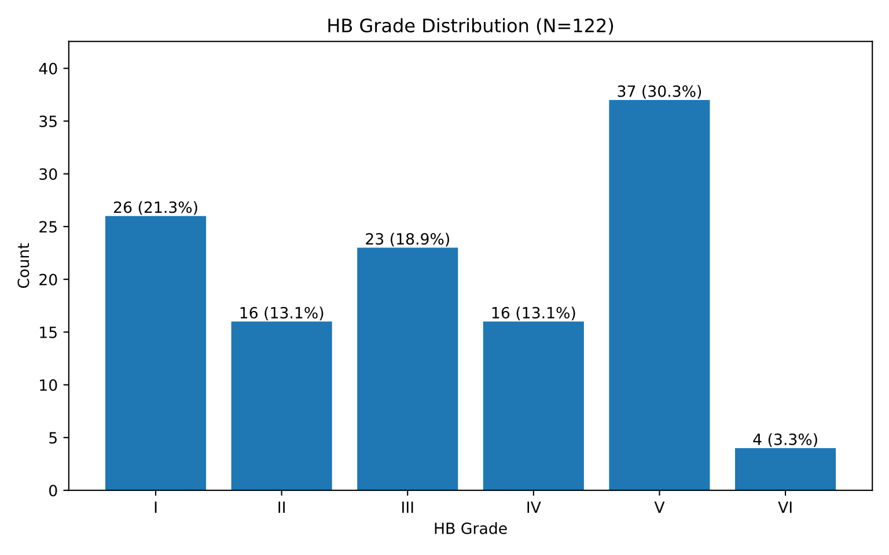
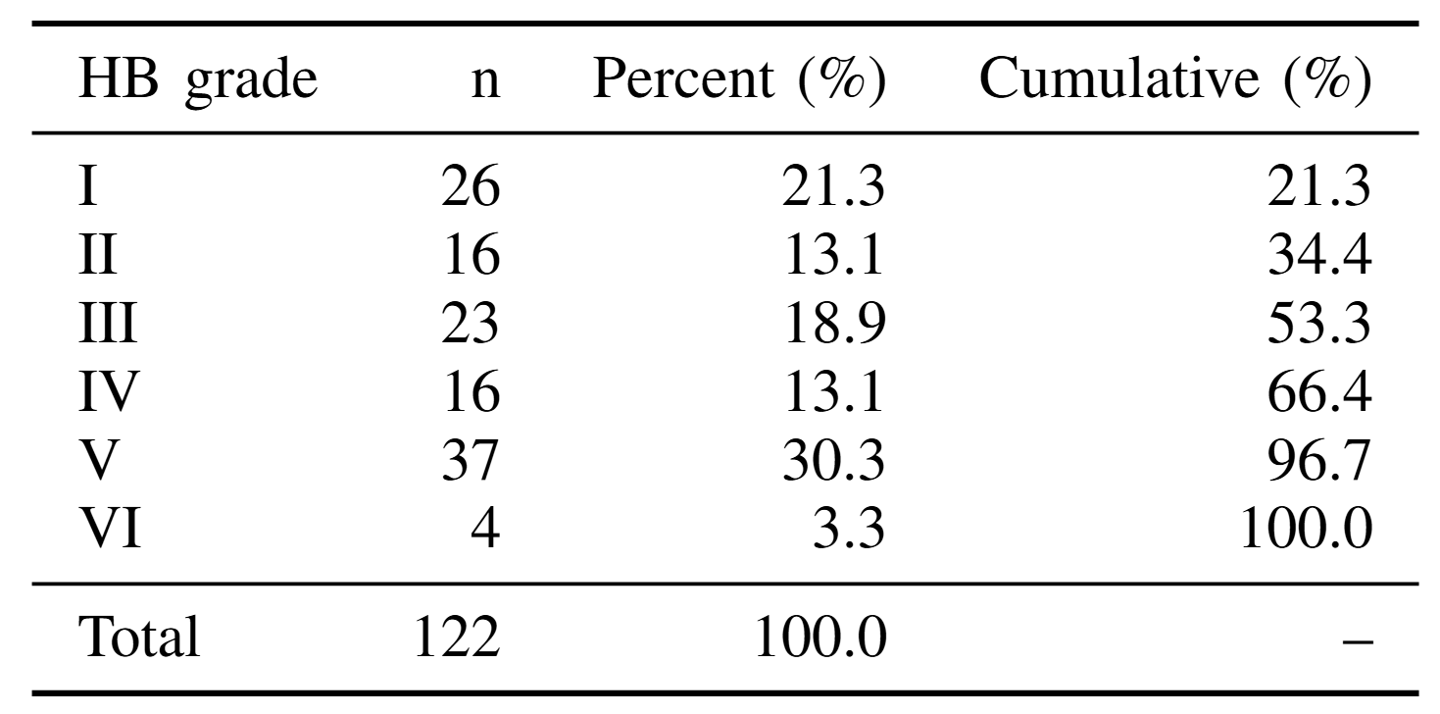
Part 7 Results
Figure 1. Distribution of House–Brackmann (HB) grading in patients with facial paralysis
A total of 122 patients with idiopathic facial paralysis were evaluated. The distribution shows a predominance of HB grade V (n = 37, 30.3%), followed by grade I (n = 26, 21.3%) and grade III (n = 23, 18.9%). Clinically, approximately one-third of the cases were classified as moderate to severe (HB grade V–VI).

Slide 9
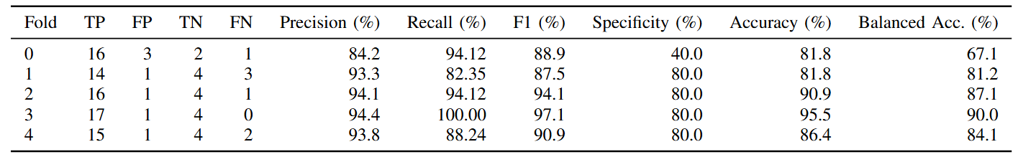
Part 7 Results
Figure 2. Diagnostic performance of the proposed intelligent speech analysis model
Five-fold cross-validation demonstrated robust classification performance with recall ≈ 92%, precision ≈ 92%, and F1 score ≈ 92%. Specificity fluctuated between 40%–80% due to class imbalance, with an overall specificity of 72%. The balanced accuracy was 81.9%, suggesting stable discriminative ability despite sample imbalance.

Slide 10
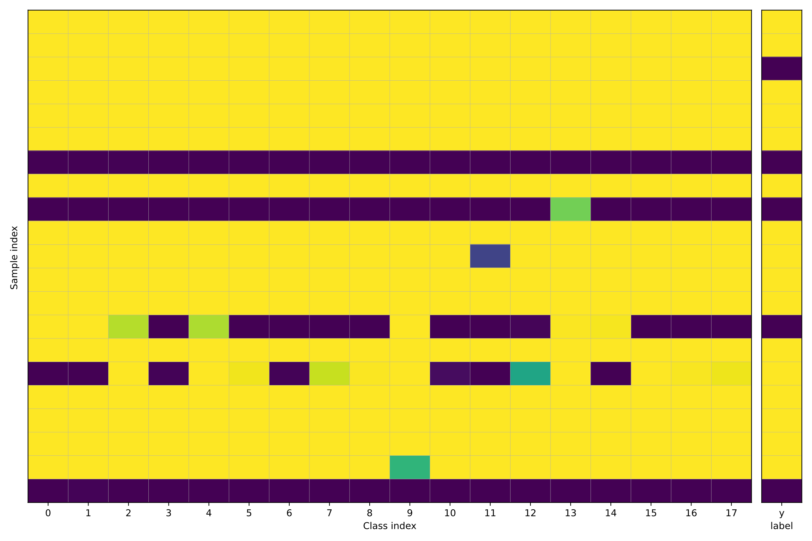
Part 7 Results
Figure 3. Sentence-level prediction heatmap with majority voting for subject-level diagnosis
Each row represents one subject, and the x-axis (18 columns) corresponds to binary predictions (0/1, color-coded) for 18 recorded sentences. The rightmost column indicates the true label (y). Final subject-level prediction was determined by majority voting (≥10 positive votes classified as positive). Stable and correct predictions appear as consistent color alignment with the true label, whereas sporadic mismatches indicate local errors, and widespread misalignment suggests systematic misclassification or noise influence.

Slide 11
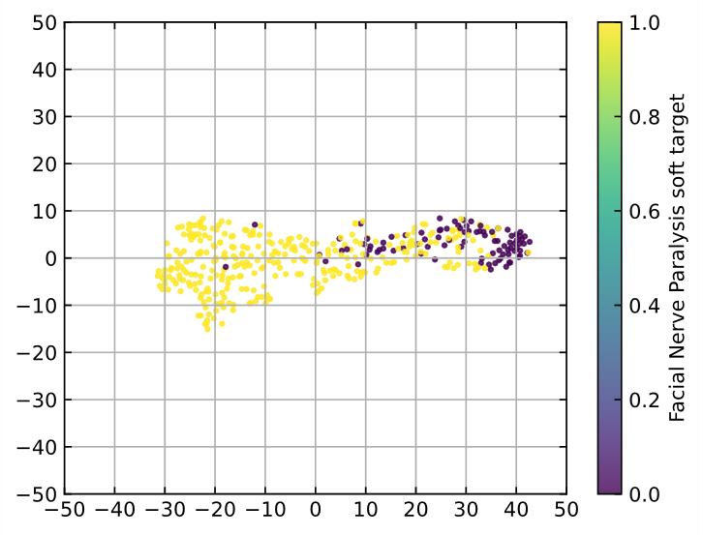
Part 7 Results
Figure 4. t-SNE visualization of speech feature embeddings
High-dimensional speech features extracted by the model were reduced to two dimensions using t-SNE for visualization. Each point represents one speech sample (sentence-level embedding), with color/marker denoting the true class (healthy vs. facial paralysis, or HB grades). Clustering indicates intra-class similarity and easier classification, while overlapping regions highlight potential confusion due to feature similarity or noise. Outliers may reflect variations in recording quality, speech rate, accent, or disease stage. Note that t-SNE axes have no physical meaning and should be interpreted only in terms of local neighborhood relationships.

Slide 12
Part 8 Key Findings
• First speech biomarker database for facial paralysis
• DAFESTS enables:
Early detection of hidden symptoms
Risk prediction & disease trajectory tracking
Effectiveness evaluation
• Compared with traditional methods:
Objective
Low-cost
Quantifiable

Slide 13
Part 9 Clinical Impact
• Provides new tool for diagnosis & therapeutic management
• AI-driven → objective, interpretable, scalable
• Potential Expansions:
Multilingual Speech Database
Telemedicine and Mobile Health Applications

Slide 14
Part 10 Conclusion
• DAFESTS = innovative AI-based speech diagnostic platform
• Enables precision medicine & personalized treatment for facial paralysis
• Supports evidence-based evaluation of treatment outcomes

Slide 15
THANKS！
FDI World Dental Congress 2025 - Oral Presentation
Notes:
换照片

